Slide 1
Electronics Simulation
Skills Clinic 2016

Slide 2
Outline
The need for circuit protection
Types of circuit protection
Reverse polarity
Over-voltage
Over-current
Complete isolation

Slide 3
Why is protection needed
Electronics connect to the real word
Non-ideal environment
If not prevent destruction, at least contain it
Rather destroy a R20 transistor than a R500 processor

Slide 4
Reverse Polarity protection

Slide 5
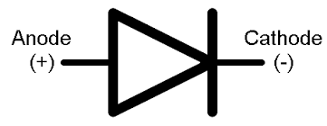
Reverse polarity protection
Simple to accomplish
Almost too simple not to deploy
How
Place a diode in series with the voltage input

Slide 6
Over-Voltage protection

Slide 7

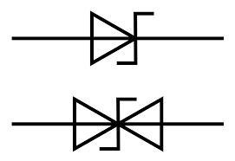
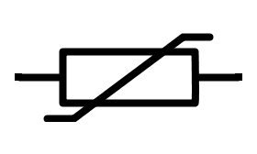
Over-voltage protection
In simple cases
Zener diode
In more extreme cases
Crowbar circuits
Transient Voltage Suppressors (TVS diode) also transorb
Very extreme cases (lightning strike)
MOVs
Spark Gaps

Slide 8
Over-Current Protection

Slide 9
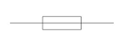
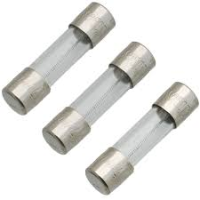
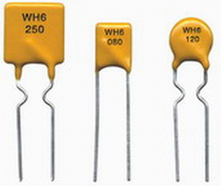

Over-Current Protection
Glass fuse
Typical way of doing it
Non-resettable
Slow but fast-blow available
Positive / Negative Temperature coefficient devices (PTC, NTC)
Known as a polyfuse
Resettable (by removing fault conditions)
Slow

Slide 10
Isolation

Slide 11
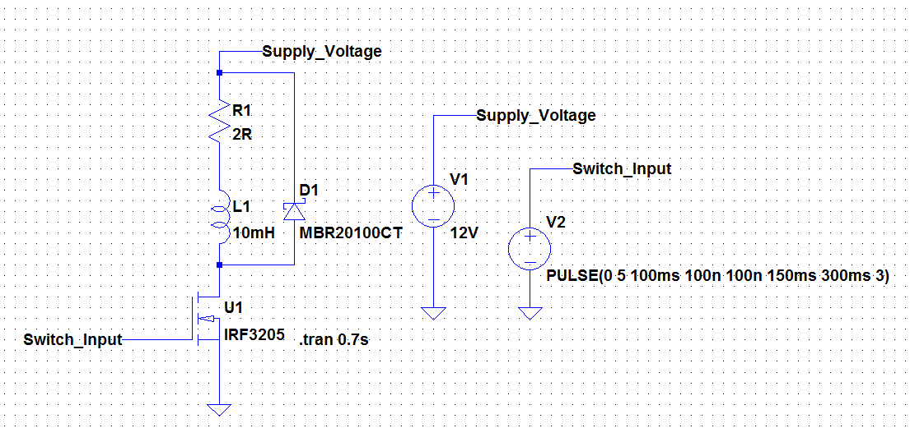

When to use isolation
When galvanic isolation is required
When high-power and low-power circuits must be connected
To avoid ground loops from occurring
When various voltage levels are involved
What happens to devices connected here?

Slide 12
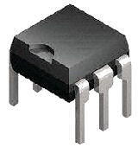
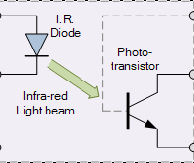
Isolation devices
In AC systems
Transformers get the job done
In DC systems
Opto-couplers / Opto-isolators

Slide 13
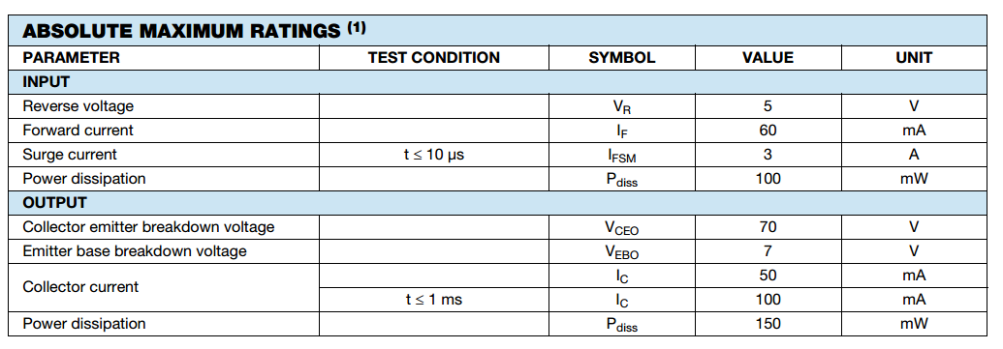
Opto-isolators – parameters
Important specifications (consider the 4N25)

Slide 14
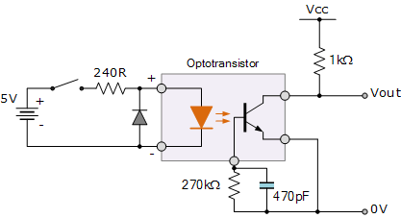
Opto-Isolators - usage

Slide 15
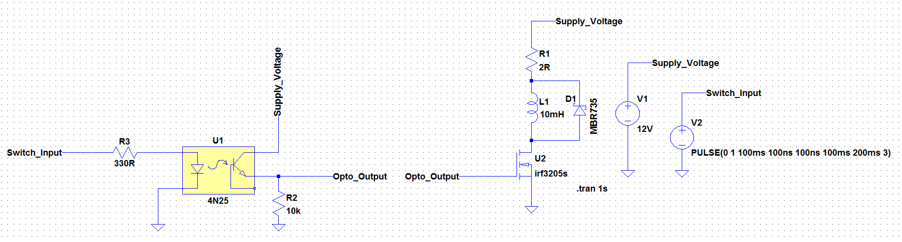
Opto-couplers - simulation

Slide 16
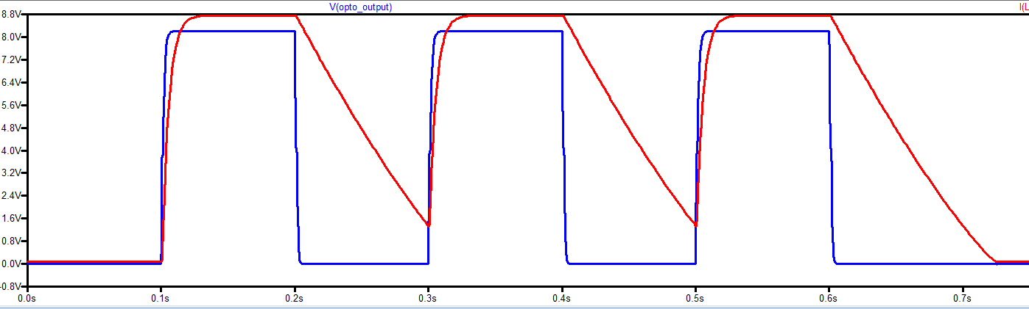
Simulation – What is going on here

Slide 17
Conclusion
Circuit protection is multi-faceted
No hard-and-fast rules
Isolation is very important for “switching” circuits
Simulation of isolation differs slightly from physical circuits

Slide 18
Next lecture
How to apply circuit protection, and the use of so called “gate drivers”

